Slide 1
Building a Modern Database Architecture with Azure

Slide 2
Notes
09:00
Laughing Boy
Your session “Building a Modern Database Architecture with Azure” has currently got 21 delegates registered out of a possible 48 places.
Your room monitors are Satya Jayanty, Emma Dolling
Breaks with snacks are from 10.30am until 11am, lunch is from 12.30 to 1.30pm and afternoon break with snacks is 3pm to 3.30pm. Tea and coffee is available all day however if you have additional breaks please ask your delegates to respect the fact that other sessions are still going.
Can you please ask your delegates to ensure they complete their session feedback form and event feedback form which will be distributed by the helpers during the afternoon break.
When you arrive at the venue can you please let us know at the Information desk that you have arrived, ideally at least 30 minutes before your session is due to start.
If you would like us to print your handouts please ensure it is emailed to speakers@sqlbits.com by no later than 17th February. However we would like to remind you that we'll cover the cost of printing up to 25 pages, b&w, double sided, so 50 pages. If you have 3 x slides per page then that covers 150 slides.
If you need any travel assistance please contact us and we’ll endeavour to help.
If you have any other questions or would like any other information please don’t hesitate to contact us and we look forward to seeing you in Manchester.

Slide 3
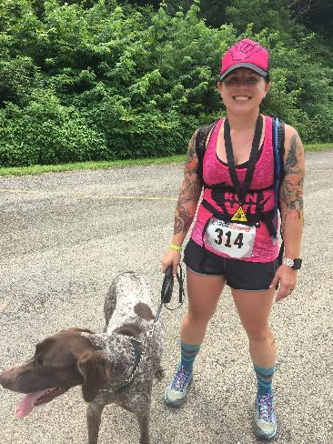
Jes Borland Premier Field Engineer – Data & AI Microsoft jes.borland@microsoft.com @grrl_geek LessThanDot.com

Slide 4
Azure fundamentals

Slide 5
Azure’s reach
95% of Fortune 500 companies trust Azure
54 regions worldwide
70+ compliance offerings

Slide 6
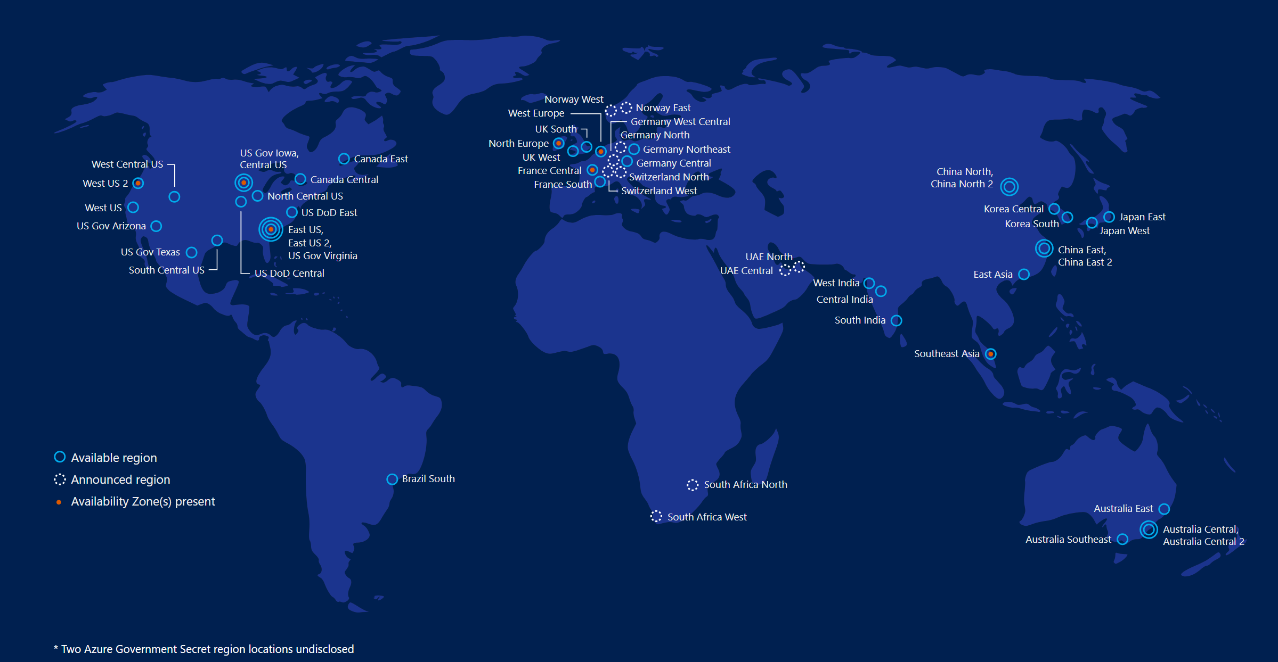
Regions

Slide 7
Compliance
More certifications than any other cloud provider
HIPAA/HITECH
HITRUST
PCI DSS
ISO 9000
You own and control your data
Azure Trust Center - https://www.microsoft.com/en-us/trustcenter/CloudServices/Azure

Slide 8
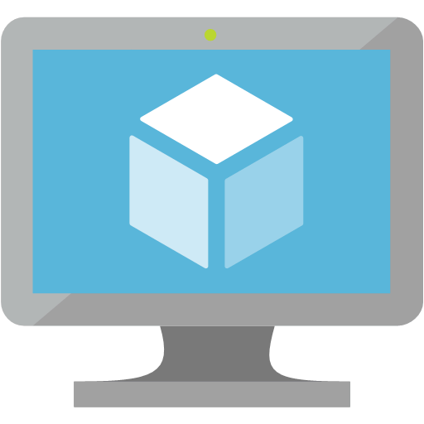
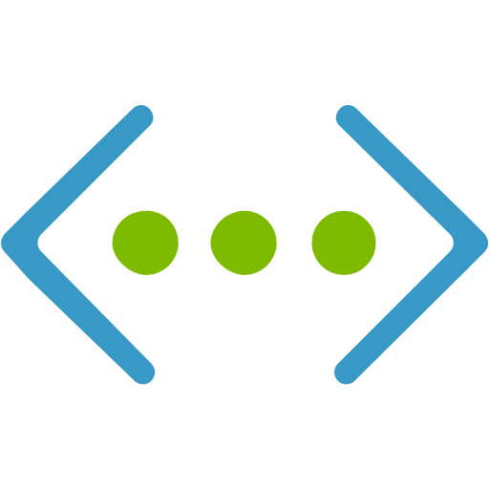
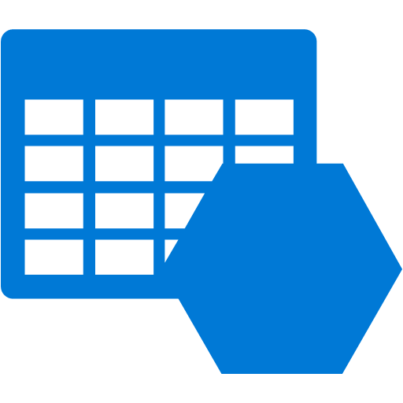
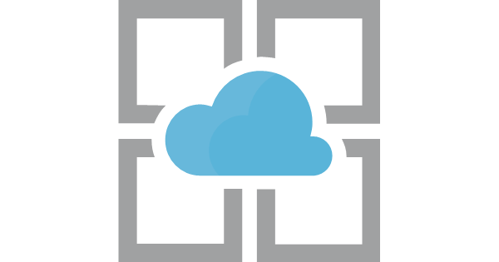
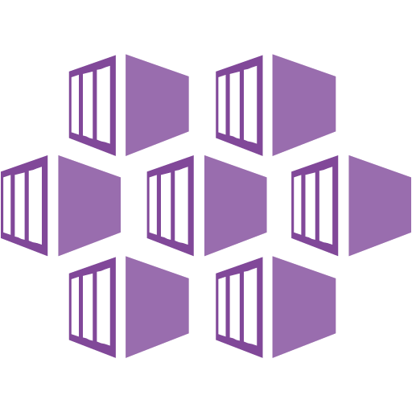

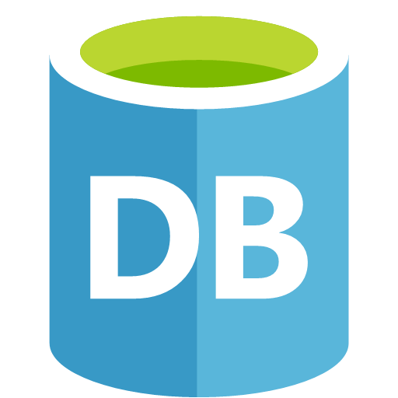

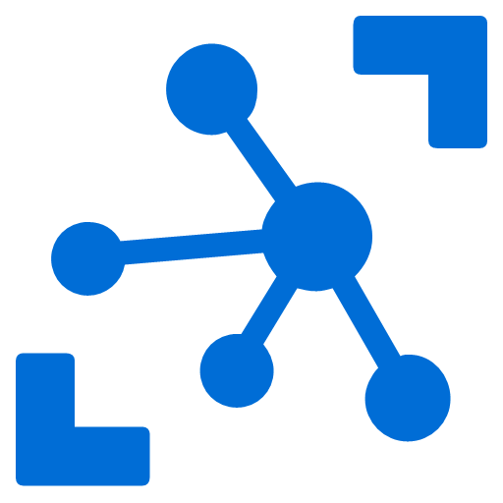
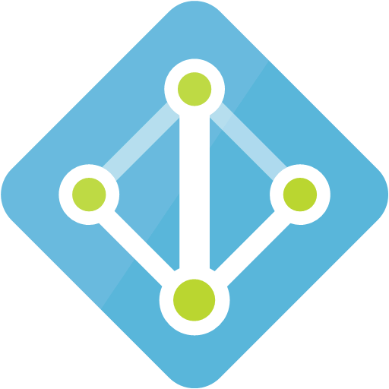
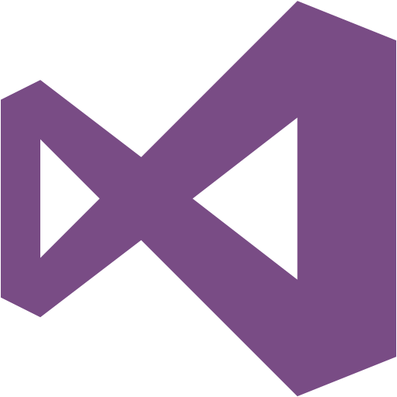

Categories of services
Compute | Networking | Storage | Web + Mobile
Containers | Data + Analytics | Databases | AI + Cognitive Services
IoT | Security + Identity | Developer Tools | Monitoring + Management

Slide 9
Cloud service models
IaaS
Renting infrastructure
PaaS
Services to create software, without worrying about infrastructure
SaaS
Software delivered on an as-needed basis

Slide 10
Pizza as a Service
Made at Home
Take and Bake
Pizza Delivered
Dine Out
You Manage
Dining Table
Dining Table
Dining Table
Dining Table
Vendor Manages
Soda
Soda
Soda
Soda
Electric/Gas
Electric/Gas
Electric/Gas
Electric/Gas
Oven
Oven
Oven
Oven
Fire
Fire
Fire
Fire
Pizza Dough
Pizza Dough
Pizza Dough
Pizza Dough
Tomato Sauce
Tomato Sauce
Tomato Sauce
Tomato Sauce
Toppings
Toppings
Toppings
Toppings
Cheese
Cheese
Cheese
Cheese
Traditional
On-Premises
(On-Prem)
Infrastructure
as a Service
(IaaS)
Platform
as a Service
(PaaS)
Software
as a Service
(SaaS)
Notes:
The Azure Pizza Analogy
Breaking down how traditional environments, IaaS, PaaS, and SaaS compare to different types of pizza delivery and pizza businesses can help us understand what we get out of each type of service and who is responsible for the different components.
Traditional Environments (Make Your Pizza at Home) – You are responsible for everything. You need a place to fully cook the pizza. You need all of the ingredients including a place where the pizza is going to be served. You need your own pizza oven. The time and work going into all aspects of putting the sauce together, cutting up the vegetables, pepperoni, and other toppings is your responsibility. If you are going to take this on you are likely going to need a full staff to man each station and people to maintain and clean the equipment and the kitchen / restaurant. If you aren’t opening up your own pizza business this would be an extremely high cost. You can try and make it cheaper by using a cheaper over, cheaper ingredients, and cutting corners here and there, but the model in and of itself has a high price in its design.
Infrastructure as a Service (IaaS) – You are responsible for some of the effort, but not all of it. You need to cook the pizza in a basic oven, supply anything to drink, and a place to eat the pizza.. But this has no where near the overhead of running your own pizza restaurant. Just go to the grocery and pizza up a frozen pizza. You can pick an expensive one put together with fresh ingredients from the deli.. Maybe with dough made onsite or you can get a cheaper one from the store in the freezer section.
Platform as a Service (PaaS) – You need a place to eat the pizza and maybe something to go along with it like a salad or something to drink, but that is about it. The pizza delivery company takes care of everything else. Again, you can control the cost. You can get fast and cheap, or go with a local specialty restaurant that is more expensive with much better quality.
Software as a Service (SaaS) – This is the opposite of the traditional environment. The restaurant does everything. Just show up with shirt, shoes, and money and you can sit down and enjoy your pizza with a menu and options. You don’t need to bring a place to sit, drinks, salad, anything but yourself. The restaurant does it all.
Reference: http://blogs.technet.com/b/daven/archive/2014/08/05/pizza-as-a-service.aspx

Slide 11
SQL Server as a Service
Traditional
On-Premises
(On-Prem)
SQL Server Engine
Analysis Services
Integration Services
Reporting Services
Physical servers or virtual servers
Infrastructure
as a Service
(IaaS)
SQL Server Engine
Analysis Services
Integration Services
Reporting Services
Virtual servers
Platform
as a Service
(PaaS)
SQL Database
SQL Data Warehouse
MySQL
PostgreSQL
CosmosDB
Software
as a Service
(SaaS)
Power BI
Office 365
Dynamics 365

Slide 12
Management Tools

Slide 13
Portal
Go to http://portal.azure.com to sign in
GUI access to most Azure services
Mobile app for iOS and Android now available - https://azure.microsoft.com/en-us/features/azure-portal/mobile-app/

Slide 14
PowerShell
The preferred method for automation
AzureAz is built on .NET Standard, allowing it to run on multiple platforms
It can be run from your machine, or using CloudShell
Instructions: https://docs.microsoft.com/en-us/powershell/azure/install-az-ps?view=azps-1.1.0
Documentation: https://docs.microsoft.com/en-us/powershell/azure/get-started-azureps?view=azps-1.1.0

Slide 15
CLI
Command-line tool designed to make scripting easy, query data, support long-running operations, and more.
Runs in the Portal, and on Windows, Mac, and Linux.
Documentation: https://docs.microsoft.com/en-us/cli/azure/install-azure-cli?view=azure-cli-latest
Choosing the right tooling for Azure and side by side Azure CLI and PowerShell commands https://blogs.msdn.microsoft.com/premier_developer/2017/11/02/choosing-the-right-tooling-for-azure-and-side-by-side-azure-cli-and-powershell-commands/

Slide 16
Networking

Slide 17
Cross-premises connectivity
Point-to-site VPN
Configured on each client computer
Doesn’t require a compatible VPN device
Doesn’t require an internet-facing IPv4 IP address
https://docs.microsoft.com/en-us/azure/vpn-gateway/vpn-gateway-howto-point-to-site-resource-manager-portal
Site-to-site VPN
Configure compatible VPN device with Azure VPN Gateway
VPN device must have an Internet-facing IPv4 IP address
https://docs.microsoft.com/en-us/azure/vpn-gateway/vpn-gateway-howto-site-to-site-resource-manager-portal
Express Route
Dedicated private connection facilitated by a connectivity provider
Connections don't go over public internet
Choice of bandwidth
“More reliability, faster speeds, lower latencies and higher security”
https://docs.microsoft.com/en-us/azure/expressroute/expressroute-introduction
Azure 101: Networking Part 1- https://blogs.msdn.microsoft.com/cloud_solution_architect/2018/10/05/azure-101-networking-part-1/

Slide 18
Virtual Networks
A representation of your network inside Azure
VNets can be connected to each other, and your on-premises network
VNets can be divided into subnets
VNet peering enables you to connect two VNets in the same region through the Azure backbone

Slide 19
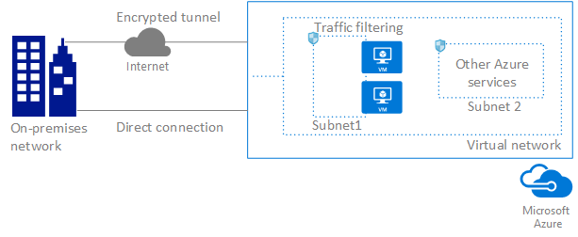

Slide 20
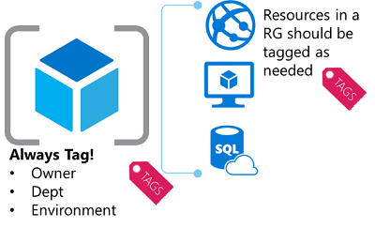
Isolating resources within Azure
Subscriptions
Divide up access to resources
Assign users to subscriptions
Enable role-based access within the subscription
Virtual Networks & Subnets
Determine which resources can communicate with each other and other networks
Resource Groups
Put resources into meaningful groups for management, billing, or affinity
Resources belong to one group
Tags
Metadata about any resource
Up to 15 key:value pairs
Common: Department, Resource Owner, Environment Type
Azure enterprise scaffold - prescriptive subscription governance - https://docs.microsoft.com/en-us/azure/azure-resource-manager/resource-manager-subscription-governance

Slide 21
Storage

Slide 22
Blob
Unstructured object storage
Account > Container > Blob
Block - optimized for streaming and storing cloud objects
Append - optimized for append opeartions
Page - optimized for representing IaaS disk and random writes

Slide 23
Table
Structured dataset storage
NoSQL key:value storage
Account > Table > Entity

Slide 24
Queue
Holds messages
Account > Queue > Messages

Slide 25
File
SMB protocol

Slide 26
Disk
For IaaS (VMs)
HDD or SSD
Unmanaged or Managed

Slide 27
Storage replication for data safety
Set at the storage account level
LRS - Locally redundant storage
3 copies within a single data center in a single region
ZRS - Zone redundant storage
3 copies in 2-3 data centers, in 1 or 2 regions
GRS - Geo-redundant storage
Recommended level
6 copies - 3 copies in primary region, 3 copies in secondary region
RA-GRS - Read-access geo-redundant storage
Same as GRS, but the data in the secondary region has read access

Slide 28
Security

Slide 29
Authentication
How do enterprise users connect to Azure and its services?
Azure Active Directory
PaaS offering
AD Connect
Integrate on-premises Active Directory with Azure Active Directory
Active Directory Federation Services
Users sign in to Azure AD-based services with their on-premises passwords
While on the corporate network, they don't have to enter their passwords again

Slide 30
Role based access control
Who has access to which resources?
What level of access do they have?
Many built-in roles; custom roles can be created
Notes:
Go to a resource and choose Access control
Can add permissions from Azure AD – user, group, application
Built-in roles: https://docs.microsoft.com/en-us/azure/active-directory/role-based-access-built-in-roles
Custom roles can also be created.

Slide 31
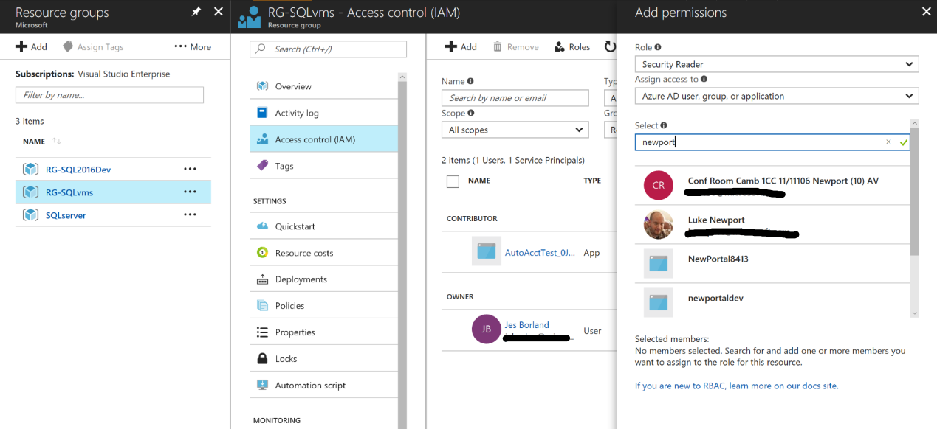

Slide 32
Data options

Slide 33
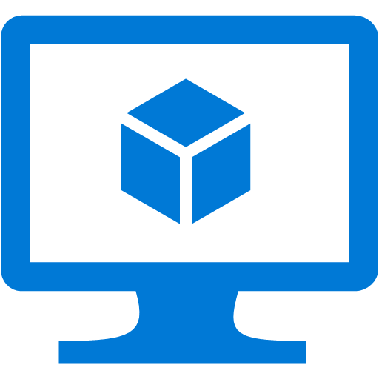

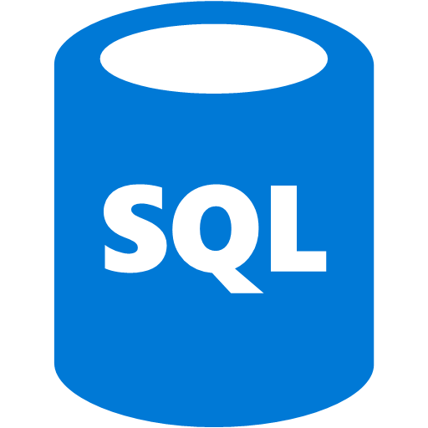


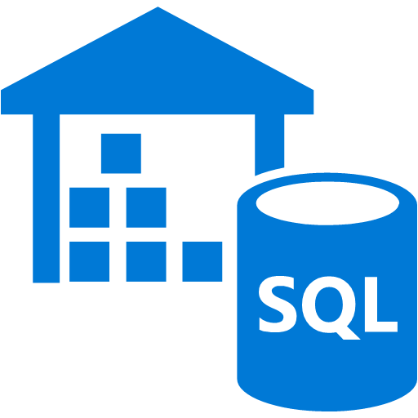
Current Azure Database Offerings
SQL Server in VMs
SQL Database
Single database
Elastic pools
Managed Instances
SQL Data Warehouse
Cosmos DB
Azure Database for MySQL
Azure Database for PostgreSQL

Slide 34
Why use SQL Server in VMs?
Run a full version of SQL Server – all features, all additional services (SSIS, SSAS, SSRS, R)
Scalable VM size
Some built-in HA and maintenance

Slide 35
Why use SQL Database?
Built-in maintenance, monitoring, and HA – worry about code, not maintenance
Easily scale up or down to accommodate load
Cloud-first development

Slide 36
Why use Managed Instances?
Benefits of SQL Database
Automatic management of patches, updates, and backups
Easy scalability
Cloud-first feature development
Drawbacks of SQL Database
Limited surface area - major features missing
Lack of cross-database communication
Solving the Problem
Managed Instances: a PaaS offering combining the managed services of SQL Database with the compatibility and server-level options of SQL Server

Slide 37
Why use SQL Data Warehouse?
You need a massively parallel processing (MPP) relational database
You can pause and resume compute resources to save money
Optimized for data warehouse workloads

Slide 38
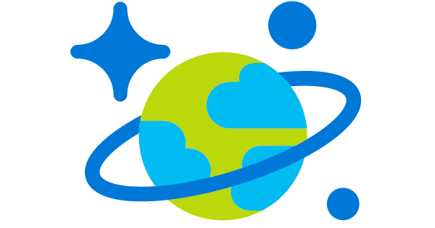
Why use Cosmos DB?
Multiple NoSQL data stores to choose from – Document, Cassandra, MongoDB, and more
Five consistency levels to strike a balance between database consistency and application responsiveness
Multi-master writes
Global distribution
Guaranteed performance SLAs
Notes:
Models
DocumentDB API
"provides rich and familiar SQL query capabilities with consistent low latencies over schema-less JSON data"
MongoDB API
"Cosmos DB databases can be used as the data store for apps written for MongoDB"
Table API
For Azure Table Storage
Graph (Gremlin) API
Graph databases provide modeling on entities and relationships between them.

Slide 39
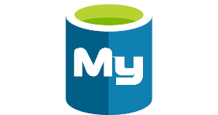
Why use MySQL as a Service?
Scale up and down, depending on current workload
Built-in monitoring and alerting
99.99% availability SLA
Point-in-time restore
Security - physical security of assets, data secured at-rest, SSL connections required
Notes:
Docs: https://docs.microsoft.com/en-us/azure/mysql/
Introductory video: https://channel9.msdn.com/Shows/Azure-Friday/Azure-DB-for-MySQL?term=mysql%20azure
Tutorial: https://docs.microsoft.com/en-us/azure/app-service-web/app-service-web-tutorial-php-mysql?toc=%2fazure%2fmysql%2ftoc.json

Slide 40
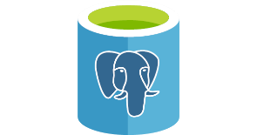
Why use PostgreSQL as a Service?
Scale up and down, depending on current workload
Built-in monitoring and alerting
99.99% availability SLA
Point-in-time restore
Security - physical security of assets, data secured at-rest, SSL connections required
Notes:
Docs: https://docs.microsoft.com/en-us/azure/postgresql/overview
Introductory video: https://channel9.msdn.com/Shows/Azure-Friday/Introducing-Azure-DB-for-PostgreSQL?term=postgresql%20azure
Tutorial: https://docs.microsoft.com/en-us/azure/app-service-web/app-service-web-tutorial-docker-python-postgresql-app?toc=%2fazure%2fpostgresql%2ftoc.json

